Slide 1


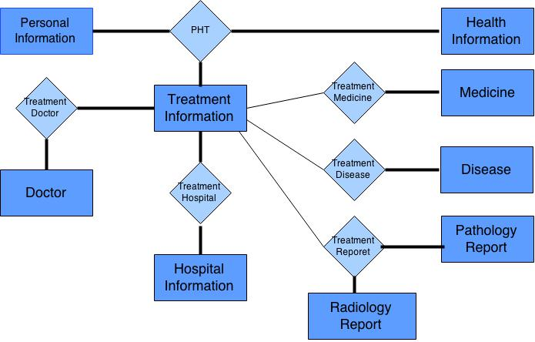

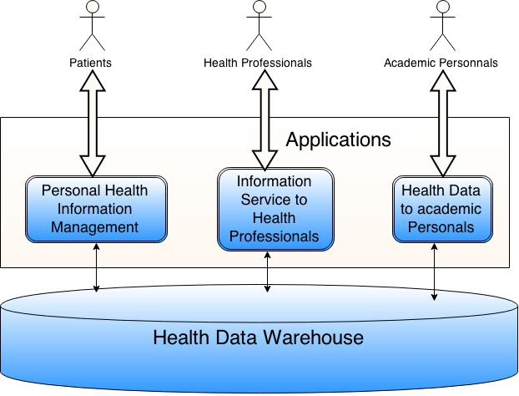

Electronic Health Record : Bangladesh Perspective
MD. Shafaul Anjum(0905044), Md.Sharif Shadat Hossain(0905083)
Medical history required for health services for a person are:
a) Disease b) Checkups, and c) Accident
Medical Service providers are:
a) Hospital b) Diagnostic centre
c) Physicians d) Others
Electronic Health Record (EHR) works with these entities coherently to provide services for:
a)Personal medical history
b)Appropriate information to medical personnel
c)Data so that knowledge can be gained by data mining
Step 2:
EHR Database Design
Step 3:
EHR System Design
Heterogeneous EHR Data:
a) Relational Database b) Text c) Images d) Videos
The problem is storage and a unified query.
Provide appropriate data to the doctor:
Effective, subjective, personalize information in shortest time
Interoperability:
Different standards are maintained by different organizations and health service providers.
Step 1:
Analysis of:
  LIS (Laboratory Information System) data
  HIS (Health Information System) data
  Diagnostic Center data
  National Health Report
Step 4:
EHR Software System Design and implementation
Conclusion:
    What has been done:
    Current Govt. programs regarding health services has been analyzed.
    Working procedure of Hospital and diagnostic center has been analyzed.
    Database design has been done.
    System architecture has been designed.
What will be done:
The database will be implemented.
Data will be gathered for the database.
The data will be analyzed using data mining tools.
    Application:
    Lessen the burden for patients.
    Help health professionals to diagnose patients.
    Help decision makers to make decisions.
Department of Computer Science and Engineering (CSE), BUET

